Slide 1
IS 467 Final Project
Names: Anishka, Suha, Andrew, Shravya
Group 23

Slide 2
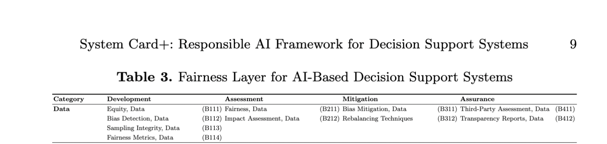
Methodology
Our dataset: HR Analytics Dataset - A dataset of 1,470 employees with demographic and job-related attributes used to model attrition. Includes features like age, gender, income, job role, satisfaction, and overtime.
We evaluated the dataset across all Fairness–Data subsections (B111–B412), aligning rubric design with the Development, Assessment, Mitigation, and Assurance stages of System Card+
For each criterion, we created a structured scoring table including a definition, an evaluation question, and a three-level scoring scale (+1, 0, –1).
Scoring was grounded in evidence from dataset documentation, exploratory data analysis, and observable structural patterns (e.g., demographic imbalances, missingness, repeated IDs).
All code, analyses, and outputs (charts, tables, CSVs) were developed in a fully reproducible pipeline hosted on our GitHub repository.
Notes:
Andrew
With this framework in place, we evaluated each System Card+ Fairness–Data area in order, beginning with B111 through B412.

Slide 3
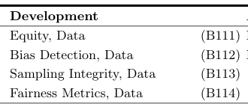
B111, B112, B113, and B114 Overview
Development
B111: Equity
Evaluates data source documentation, purpose disclosure, metadata availability, sampling visibility, and error and limitations.
0, +1, +1, –1, –1 ; Sum = 0
The results show that the dataset provides only basic information and lacks the documentation needed for fair data practices.
Key elements like sampling details, limitation reporting, and built-in fairness checks are missing, making it difficult to judge whether the data represents groups accurately or evenly.
Overall, the dataset falls short of core expectations for fairness at the data level.
B112:
Bias Detection
Evaluates representation balance, feature bias screening, outcome disparity checks, missing data pattern analysis, and bias flag reporting.
0, –1, 0, 0, –1 ; Sum = –2
B113:
Sampling Integrity
Looks at sampling frame clarity, inclusion and exclusion rules, coverage of key subgroups, sampling method transparency, and oversampling/correction strategy
–1, –1, 0, –1, –1 ; Sum = –4
B114:
Fairness Metrics
Examines if fairness metrics are defined, metric justification, group comparison reporting, threshold and cutoff transparency, and metric limitations disclosure
–1, –1, –1, –1, –1 ; Sum = –5

Slide 4
B211, B212, and B311 Overview
Assessment + Mitigation:
All analysis-phase fairness work is missing, indicating that the dataset was not evaluated for structural bias, subgroup impact, or potential harms.
These scores show that fairness risks were neither examined nor mitigated, which is especially concerning for HR and workforce analytics contexts.
B211: Fairness
Evaluates imbalance, structural bias, sensitive attributes, label quality, sampling transparency, and readiness to address issues.
-1, -1, -1, -1, 0, -1, -1 ; Sum = –6
B212:
Impact
Examines how data decisions affect different groups, including risks, missingness, assumptions, and potential harm.
-1, -1, 0, 0, -1, 0, -1 ; Sum = –4
B311:
Bias
Assesses mitigation choices, documentation, effectiveness, data integrity, rare-group handling, and new risks introduced.
-1, -1, -1, 0, -1, -1, -1 ; Sum = –6

Slide 5


B312-B412 (rubric overview + scoring)
B312: Rebalancing Techniques
Evaluates how clearly the dataset explains its collection process, sampling approach, and representativeness.
–1, –1, –1, –1, –1; Sum = -5
Across questions 3.12, 4.11, and 4.12, the dataset clearly lacks the information needed to evaluate fairness. It doesn’t explain how the data was collected, doesn’t report limitations, and offers no built-in checks for bias. Because of this, it’s impossible to tell whether the dataset represents different groups accurately or consistently.
B411:
Third-Party Assessment
Evaluates whether the dataset discloses potential biases, known errors, and limitations that could affect fairness.
–1, –1, –1, –1, –1; Sum = -5
B412:
Transparent Reports
Evaluates whether the dataset includes any built-in checks, metrics, or documentation supporting fair and equitable data use.
0, 0, 0, 0, 0;
Sum = 0

Slide 6
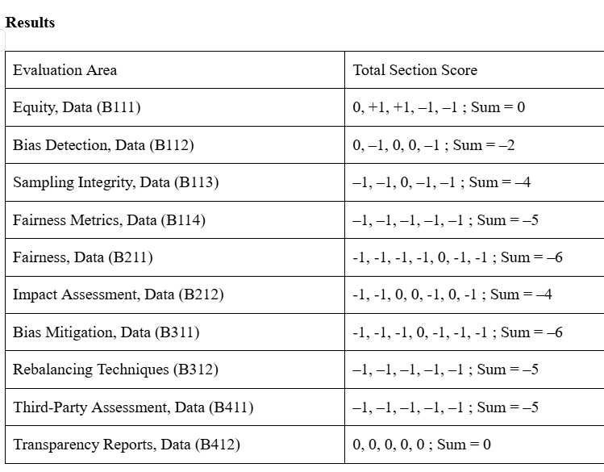
Results Summary
These results show how the HR Analytics dataset performs across the Fairness–Data criteria using our custom scoring method.
The dataset shows some strengths, such as clear purpose and basic metadata, but most sections scored poorly.
It lacks sampling information, bias documentation, fairness metrics, mitigation steps, audits, and formal transparency reporting.
Overall, the scores indicate that while the dataset is workable for analysis, it does not meet most fairness or responsible AI expectations.

Slide 7
Discussion: Key Findings
Documentation is limited (B111 = 0): Purpose and metadata exist, but no sampling details or limitations, so demographic patterns cannot be interpreted confidently.
No fairness analysis (B112 = –2, B114 = –5): No built-in bias checks, no subgroup context, and no defined fairness metrics.
Sampling and representation unclear (B113 = –4): No inclusion criteria or explanation of how demographic groups were collected or represented.
No mitigation or assurance (B211–B311 = negative, B312 = –5, B411 = –5, B412 = 0): No rebalancing, audits, or structural bias reviews; transparency limited to basic column descriptions.
Overall Pattern:
Dataset has basic metadata but lacks deeper fairness documentation
Scores across System Card+ criteria are mostly negative
Fairness risks appear across all phases of the framework
Notes:
Anishka (1.5 minute)

Slide 8
Interpretation
The dataset shows significant fairness weaknesses across almost all System Card+ Fairness–Data areas, with consistently negative scores in sampling integrity, bias detection, bias mitigation, and data rights.
Most deficiencies stem from a lack of documentation: no sampling frame, no provenance details, no fairness metrics, no assessment of subgroup impacts, and no evidence of governance or auditing mechanisms.
Although the dataset is structurally clean and easy to analyze, its limited transparency and absence of consent or mitigation practices raise substantial fairness risks for downstream HR applications.

Slide 9
Recommendations
Improve transparency and provenance by documenting dataset origin, sampling rules, processing history, and known limitations.
Conduct structured bias detection by reporting representation balance, outcome disparities, and missingness patterns across demographic groups.
Develop fairness metrics and mitigation procedures, including rebalancing options, bias-aware preprocessing, and subgroup sensitivity analyses.
Establish governance and audit processes, such as third-party review, ethical compliance checks, and ongoing monitoring of bias over time.
Include user-rights documentation detailing consent processes, data retention policies, and options for data access or withdrawal.

Slide 10
Conclusion
Using the System Card+ Fairness–Data framework, our evaluation demonstrates that the dataset does not meet the fairness expectations required for responsible operational deployment
Across B111–B412, the dataset performed inconsistently: early sections such as Equity (B111) and Bias Detection (B112) showed partial strengths in metadata clarity and interpretability, while later sections—including Sampling Integrity (B113), Fairness Metrics (B114), Mitigation (B311–B312), and Assurance (B411–B412)revealed substantial gaps in transparency, governance, documentation, and user-rights protections.
Our project demonstrates how structured fairness evaluation at the data layer provides insight into the systemic responsibilities required for ethical AI development
Holistic assessment underscores the importance of transparent documentation, fairness-aware data practices, and governance mechanisms
Notes:
Using the System Card+ Fairness–Data framework, our evaluation demonstrates that the dataset, as currently documented, does not meet the fairness expectations required for responsible operational deployment. This conclusion is not a judgment on the dataset’s analytical usefulness, but rather the outcome of systematically applying our rubric across all Fairness–Data criteria.
Across B111–B412, the dataset performed inconsistently: early sections such as Equity (B111) and Bias Detection (B112) showed partial strengths in metadata clarity and interpretability, while later sections—including Sampling Integrity (B113), Fairness Metrics (B114), Mitigation (B311–B312), and Assurance (B411–B412)—revealed substantial gaps in transparency, governance, documentation, and user-rights protections.
Taken together, our project demonstrates how structured fairness evaluation at the data layer provides insight not only into dataset limitations but also into the systemic responsibilities required for ethical AI development. This holistic assessment underscores the importance of transparent documentation, fairness-aware data practices, and governance mechanisms before such datasets can be safely deployed in real HR decision-making contexts.

Slide 11
Thank you!
Questions?

